Slide 1



Object-oriented programming
OOP Principles and Fundamentals
SoftUni Team
Technical Trainers
Software University
http://softuni.bg

Slide 2

Table of Contents
The principles of OOP:
Inheritance
Abstraction
Encapsulation
Polymorphism
Access modifiers.
Interfaces.
“Override” and “New” keywords.

Slide 3

Encapsulation

Slide 4
Encapsulation
Encapsulation is an information-hiding mechanism that makes code easy to maintain and understand
A class announces only a few operations (methods) available for its clients – its public interface
All data members (fields) of a class should be hidden
Accessed via properties (read-only and read-write)
Encapsulation is - hiding (encapsulating) data behind constructors and properties

Slide 5
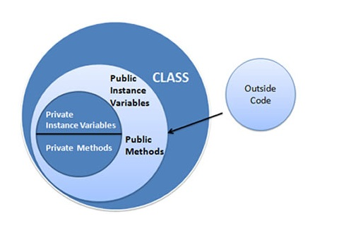
Encapsulation
Properties offer a great way to encapsulate data fields along with any accompanying logic.
Access modifiers such as private and public allow you to control the level of access for a class member or for the class itself

Slide 6

Encapsulation
Live demo
Notes:
(c) 2006 National Academy for Software Development - http://academy.devbg.org*
6##

Slide 7
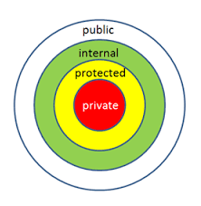
Access Modifiers

Slide 8
Access Modifiers
Access modifiers control where a type or type member can be used
All types and type members have an access level that specifies where that class or its members can be used in your code
The internal access modifier is the default for a class if no access modifier is specified

Slide 9
Access Modifiers
Access modifier | Description
public | Access is not restricted.
private | Access is restricted to the containing class.
protected | Access is restricted to the containing class or any class derived from it. (You will learn about derived classes later in the Inheritance section.)
internal | Access is restricted to the code in the same assembly.
protected internal | A combination of protected and internal – access is restricted to any code in the same assembly and only to derived classes in another assembly.

Slide 10
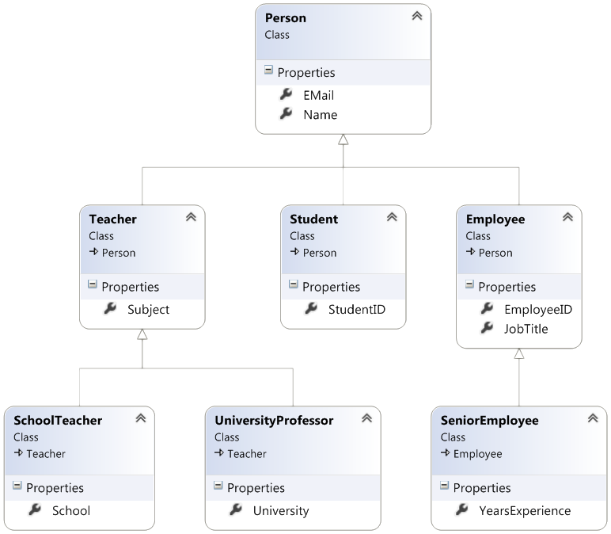
Inheritance
Notes:
(c) 2006 National Academy for Software Development - http://academy.devbg.org*
10##

Slide 11
Inheritance
Inheritance is when an object or class is based on another object or class using the same implementation to maintain the same behavior
The class that inherits the functionality is called a derived class, and the class whose functionality is inherited is called a base class

Slide 12
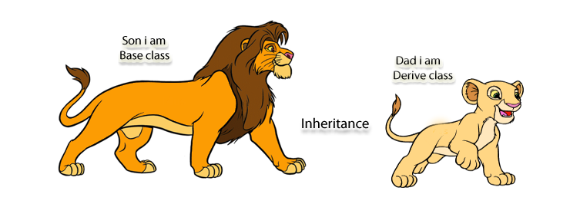
Inheritance
A derived class inherits all the functionality of the base class and can also define additional features that make it different from the base class

Slide 13
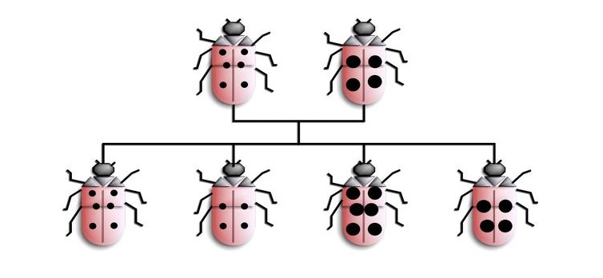
Inheritance
Live demo
Notes:
(c) 2006 National Academy for Software Development - http://academy.devbg.org*
13##

Slide 14
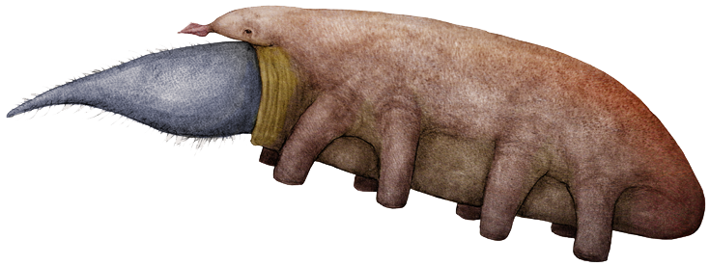
Abstraction
Notes:
(c) 2006 National Academy for Software Development - http://academy.devbg.org*
14##

Slide 15

Abstraction
Abstraction means ignoring irrelevant features, properties, or functions and emphasizing the relevant ones ...
... relevant to the project we develop
With an eye to future reuse in similar projects
Abstraction helps managing complexity
"Relevant" to what?

Slide 16
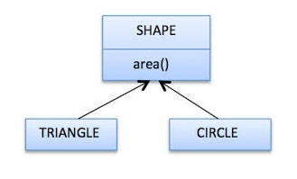
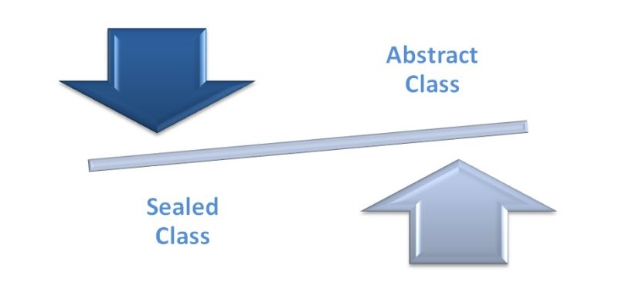
Abstract and Sealed Classes
The abstract classes provide a common definition of a base class that can be shared by multiple derived classes
Sealed classes, on the other hand, provide complete functionality but cannot be used as base classes

Slide 17
Abstract Classes
Abstract classes are partially defined classes
Represent some abstraction, not particular class
Mix between class and interface
Can be partially implemented or fully unimplemented
Not implemented methods are declared as abstract
Abstract classes cannot be directly instantiated
Child classes should implement all abstract methods
Or should be declared as abstract as well

Slide 18

Casting between Types

Slide 19
Casting between Types
In C#, the runtime allows you to cast an object to any of its base types
An object created and cast to its base type
public static void Main(string[] args)
{
Polygon a = new Rectangle(15, 15);
Rectangle b = new Square(5, 5);
Object c = new Rectangle(123, 456);
Rectangle d = (Rectangle) c;
. . .
}
An object casted back from the base class, as a Rectangle

Slide 20
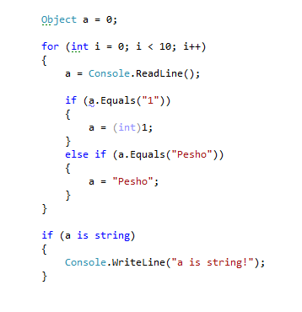
The IS and AS Operators
The is operator is used to avoid runtime errors such as the InvalidCastException
can be used to check whether the cast is allowed before actually performing the cast
returns a bool value: true if the object is the same type and false if not

Slide 21
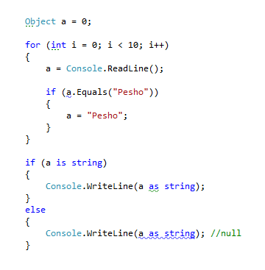
The IS and AS operators
Another useful cast operator is the as operator
Is similar to the cast operation but is safer
In the case of as, if the type conversion is not possible, null is returned instead of raising an exception

Slide 22
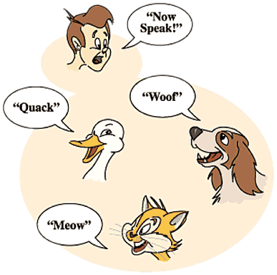
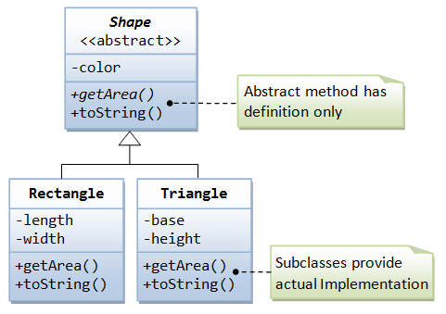
Polymorphism
Notes:
(c) 2006 National Academy for Software Development - http://academy.devbg.org*
22##

Slide 23
Polymorphism
Polymorphism = the ability to take more than one form : (objects have more than one type)
A class can be used through its parent / interface
A child class may override (change) some of the parent's methods
Polymorphism allows invoking abstract operations :
Defined in the base class / interface
Implemented in the child classes
Declared as abstract or virtual or inside an interface

Slide 24
Polymorphism – Example
Abstract class
Figure
Abstract action
+CalcSurface() : double
Concrete class
Square
Circle
-x : int
-y : int
-size : int
-x : int
-y : int
-radius : int
Overriden action
Overriden action
+CalcSurface()
+CalcSurface()
public override double CalcSurface()
{
return size * size;
}
public override double CalcSurface()
{
return Math.PI * radius * raduis;
}

Slide 25
Polymorphism – Why?
Why handle an object of given type as object of its base type?
To invoke abstract operations implemented in the child classes
To mix different data types in the same collection
E.g. List<Figure> can hold Circle and Rectangle objects
To pass more specific object to a method that expects a more generic type (e.g. SchoolStudent instead of Student)
To declare a more generic field which will be initialized and "specialized" later (in a subclass)

Slide 26
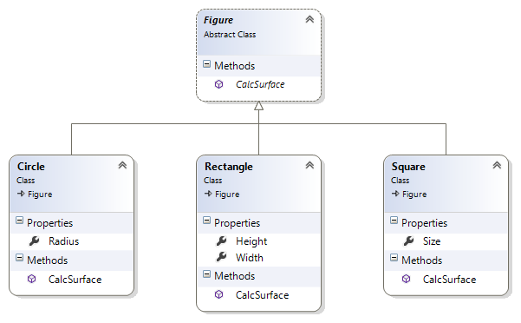
Polymorphism
Live demo

Slide 27
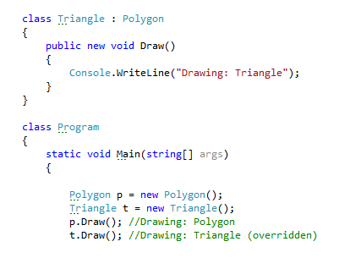
“override” and “new” keywords
The override keyword is used to replace the implementation of a base class’s member with a new member in a derived class with the same name
If the new keyword is used instead, the new member in the derived class hides the one in the base class

Slide 28

Interfaces
Notes:
(c) 2006 National Academy for Software Development - http://academy.devbg.org*
28##

Slide 29
Interfaces
An interface defines a set of operations (methods) that a given object should support:
Also called "contract" for providing a set of operations.
Defines abstract behavior, abstract capabilities.
Interfaces provide abstractions.
You invoke the abstract action.
Without worrying how it is implemented internally.
Without worrying what is the actual class which calls it.

Slide 30
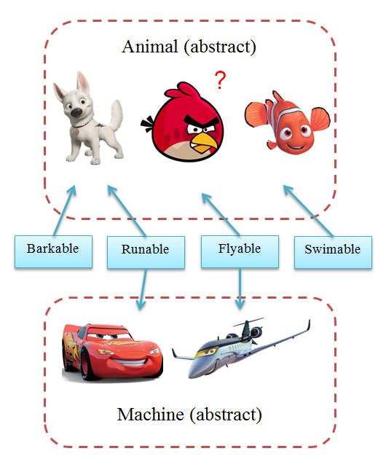
Interfaces – Example
Classes
Interfaces

Slide 31
Interfaces in C#
Interfaces in C# describe a prototype of group of methods (operations), properties and events
Can be implemented by a class or structure
Define only the signature of the methods / properties
No concrete implementations are provided
Can be used to define abstract data types
Can be inherited (extended) by other interfaces
Cannot be instantiated

Slide 32
Interfaces – Example
public interface IShape
{
void SetPosition(int x, int y);
int CalculateSurface();
}
public interface IMovable
{
void Move(int deltaX, int deltaY);
}
public interface IResizable
{
void Resize(int weight);
void Resize(int weightX, int weightY);
void ResizeByX(int weightX);
void ResizeByY(int weightY);
}

Slide 33
Interface Implementation
Classes and structures can implement (support) one or several interfaces
Implementer classes must implement all interface methods
Or should be declared abstract
class Rectangle : IShape
{
public void SetPosition(int x, int y) { … }
public int CalculateSurface() { … }
}

Slide 34

Interfaces and Implementation
Live Demo

Slide 35

Summary
The four major principles of OOP.
Abstraction and Inheritance.
Encapsulation.
Polymorphism.
Access modifiers and their use.
The is and as and how to cast between types.
What are Interfaces and how to use them?

Slide 36
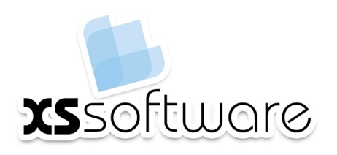







Questions
https://softuni.bg/courses/javascript-applications/

